Slide 1
Review class on IP addressing & Subnet May 18, 2020

Slide 2
IP addressing
Public / Private IP address
Network Address Translation
Subnetting

Slide 3
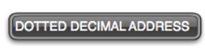
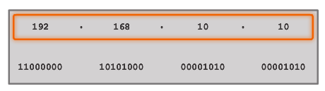
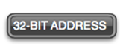
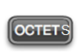
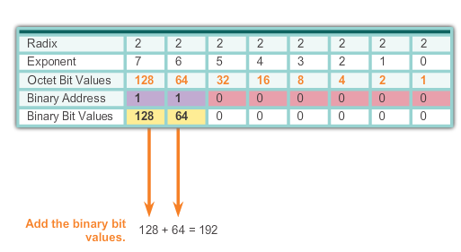
Binary Number System
Notes:
8.1.1.2 Binary Number System

Slide 4
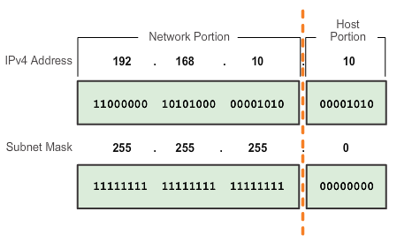
Network Portion and Host Portion of an IPv4 Address
The subnet mask just says where to look for the network portion in a given IPv4 address
Notes:
8.1.2.1 Network Portion and Host Portion of an IPv4 Address

Slide 5
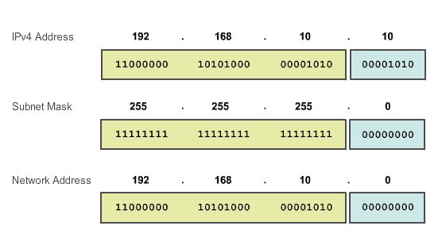
Bitwise AND Operation
Notes:
8.1.2.5 and 8.1.2.6 Bitwise AND Operation/Importance of ANDing

Slide 6
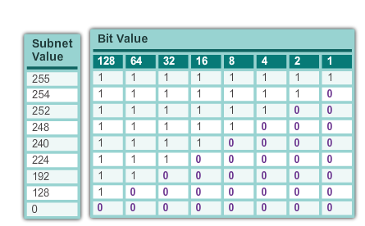
IPv4 Subnet masks
Valid Subnet Masks
Notes:
8.1.2.1 Network Portion and Host Portion of an IPv4 Address (cont.)

Slide 7
Network Address and Broadcast address
For a network, 192.168.10.0/24 network
There are 8-bit allocated for host part.
Network Address:
All 0’s in the host part: 0000 0000 = 0
So, network address = 192.168.10.0
Broadcast address:
All 1’s in the host part: 1111 1111 = 255
So, broadcast address = 192.168.10.255

Slide 8
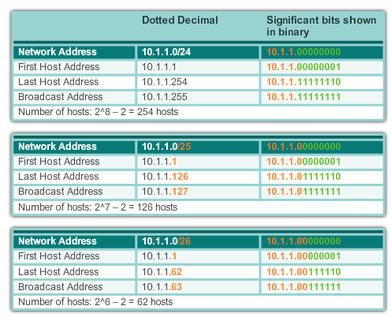
Examining the Prefix Length
Notes:
8.1.2.2 Examining the Prefix Length

Slide 9
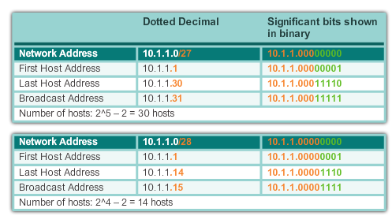
Examining the Prefix Length (cont.)
Notes:
8.1.2.2 Examining the Prefix Length (cont.)

Slide 10
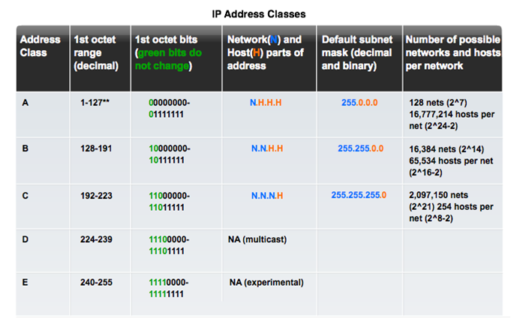
Types of IPv4 Address Legacy Classful Addressing
See if updated graphic with top row in text case for consistency.
Notes:
8.1.4.4 Legacy Classful Addressing

Slide 11
Classless Addressing
Formal name is Classless Inter-Domain Routing (CIDR)
Created a new set of standards that allowed service providers to allocate IPv4 addresses on any address bit boundary (prefix length) instead of only by a class A, B, or C address
Example:
192.168.10.0/23
Notes:
8.1.4.4 Legacy Classful Addressing (cont.)

Slide 12
Private IP address

Slide 13
Public and Private IPv4 Addresses
Private address blocks are:
Hosts that do not require access to the Internet can use private addresses
10.0.0.0 to 10.255.255.255 (10.0.0.0/8)
172.16.0.0 to 172.31.255.255 (172.16.0.0/12)
192.168.0.0 to 192.168.255.255 (192.168.0.0/16)
Not globally routable
Address translation is done at Router to convert private IP into Public IP address and vice versa
Notes:
8.1.4.1 Public and Private IPv4 Addresses

Slide 14
What is NAT?
NAT is a process used to translate network addresses.
NAT’s primary use is to conserve public IPv4 addresses.
NAT is usually implemented at border network devices, such as firewalls or routers.
NAT allows the networks to use private addresses internally, only translating to public addresses when needed.
Devices within the organization can be assigned private addresses and operate with locally unique addresses.
When traffic must be sent or received to or from other organizations or the Internet, the border router translates the addresses to a public and globally unique address.
Notes:
11.1.1.2 What is NAT?

Slide 15
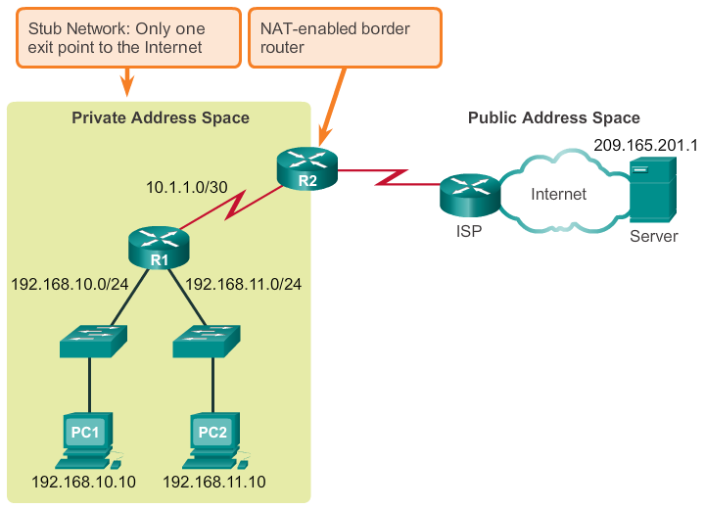
NAT
Notes:
11.1.1.2 What is NAT? (cont.)

Slide 16
Subnetting

Slide 17
Network Segmentation Reasons for Subnetting
Subnetting is the process of segmenting a network into multiple smaller network spaces called subnetworks or subnets.
Large networks must be segmented into smaller subnetworks, creating smaller groups of devices and services to:
Control traffic by containing broadcast traffic within each subnetwork.
Reduce overall network traffic and improve network performance.
Communication Between Subnets
A router is necessary for devices on different networks and subnets to communicate.
Devices on a network and subnet use the router interface attached to their LAN as their default gateway.
Notes:
9.1.1.1 Reasons for Subnetting
9.1.1.2 Communication Between Subnets

Slide 18
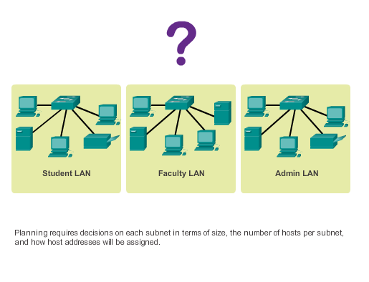
Different networks for different groups
Planning the Network
Notes:
9.1.2.1 The Plan
9.1.2.2 The Plan - Address Assignment

Slide 19
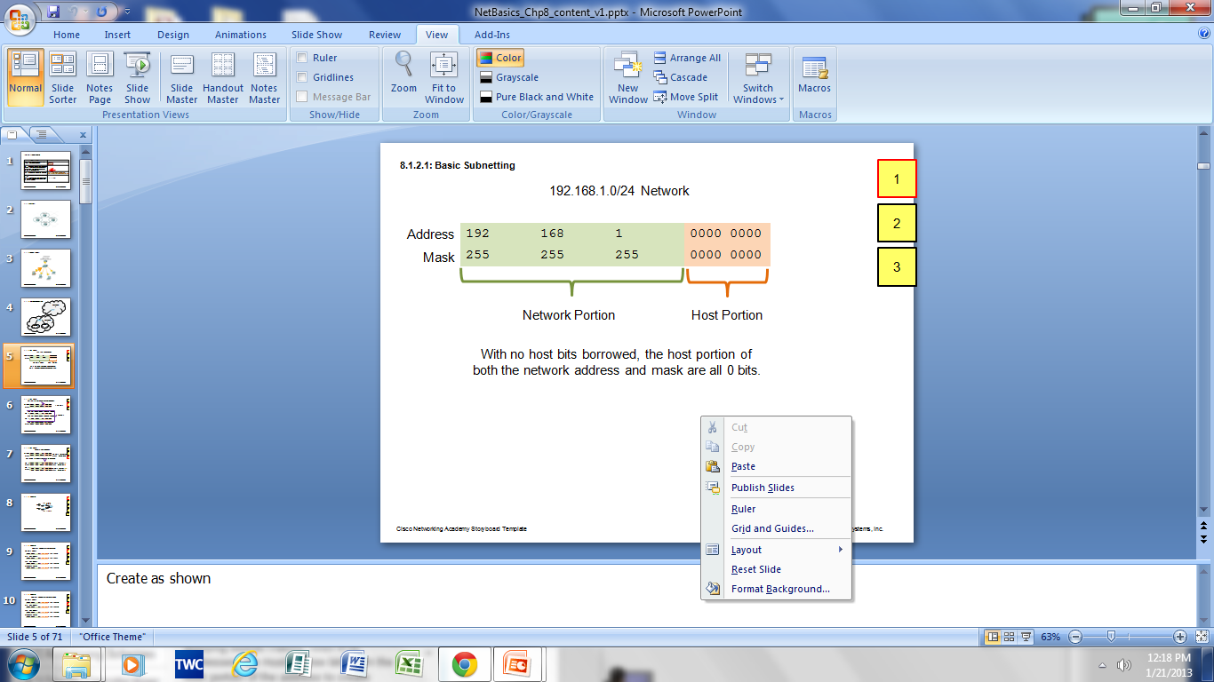
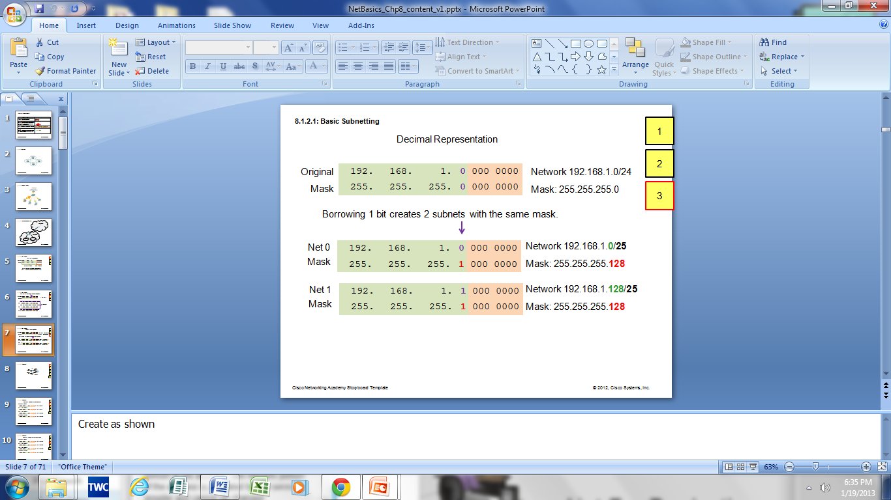
Basic Subnetting
Borrowing Bits to Create Subnets
Borrowing 1 bit 2¹ = 2 subnets
Borrowing 1 Bit from the host portion creates 2 subnets with the same subnet mask
Subnet 0
Network 192.168.1.0-127/25
Mask: 255.255.255.128
Subnet 1
Network 192.168.1.128-255/25
Mask: 255.255.255.128
Notes:
9.1.3.1 Basic Subnetting

Slide 20
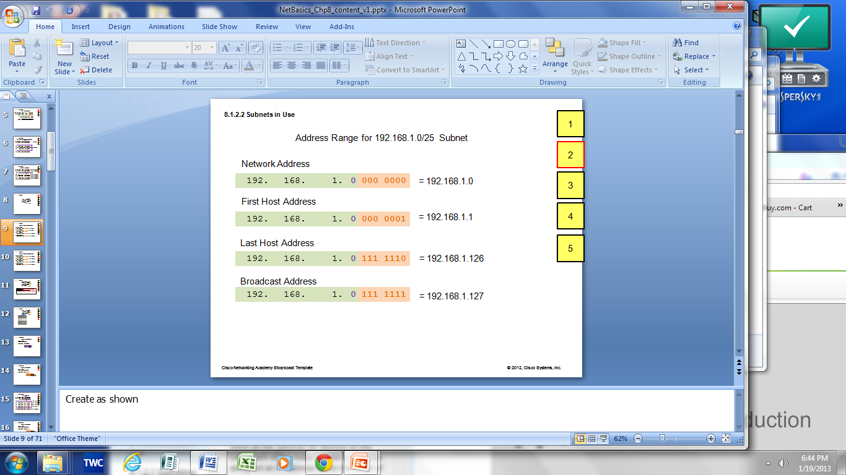
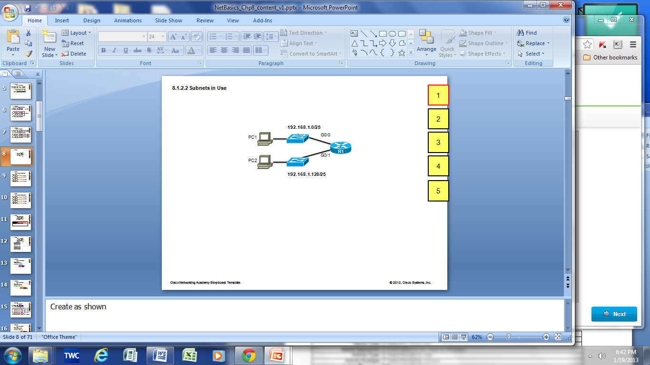

Subnets in Use
Subnets in Use
Subnet 0
Network 192.168.1.0-127/25
Subnet 1
Network 192.168.1.128-255/25
Notes:
9.1.3.2 Subnets in Use

Slide 21
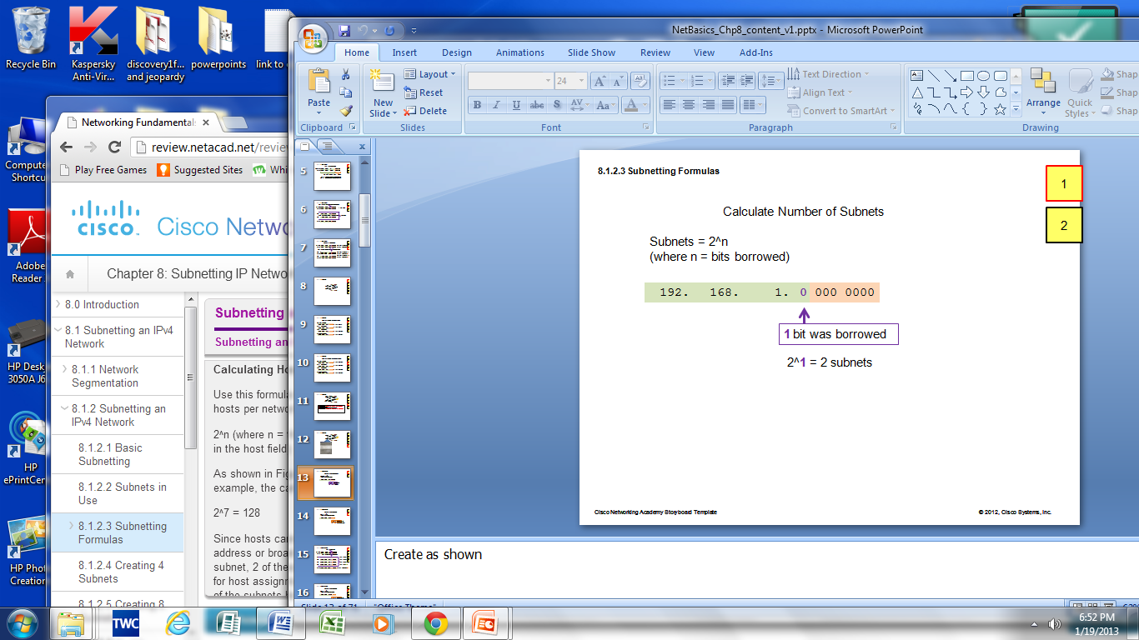
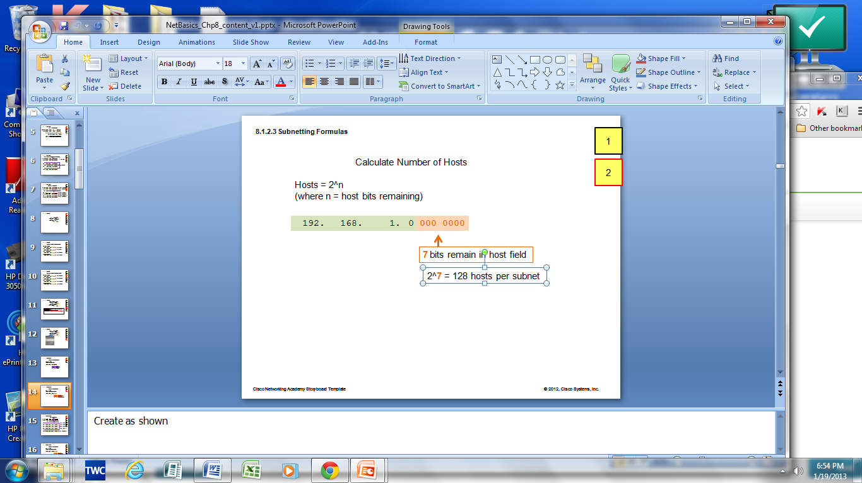
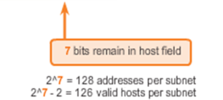
Subnetting Formulas
Calculate number of subnets
Calculate number of hosts
Notes:
9.1.3.3 Subnetting Formulas

Slide 22
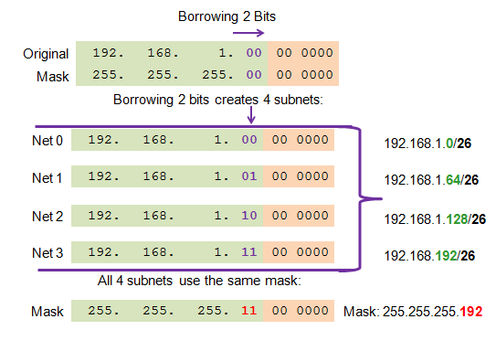
Creating 4 Subnets
Borrowing 2 bits to create 4 subnets. 2² = 4 subnets
Creating 4 Subnets
Notes:
9.1.3.4 Creating 4 subnets

Slide 23
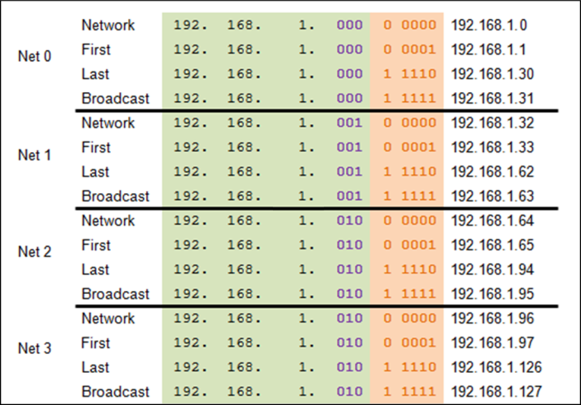
Creating Eight Subnets
Borrowing 3 bits to Create 8 Subnets. 2³ = 8 subnets
Notes:
9.1.3.5 Creating 8 subnets

Slide 24
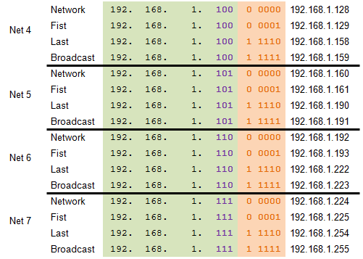
Creating Eight Subnets (Cont.)
Notes:
9.1.3.5 Creating 8 Subnets (Cont.)

Slide 25
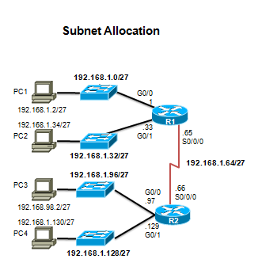
Creating Eight Subnets (Cont.)
Notes:
9.1.3.5 Creating 8 Subnets (Cont.)

Slide 26
Subnetting Based on Host Requirements
Two considerations when planning subnets:
Number of subnets required
Number of host addresses required
Formula to determine number of usable hosts: 2^n-2
2^n (where n is the number of remaining host bits) is used to calculate the number of hosts.
-2 (The subnetwork ID and broadcast address cannot be used on each subnet.)
Notes:
9.1.4.1 Subnetting based on Host Requirements

Slide 27
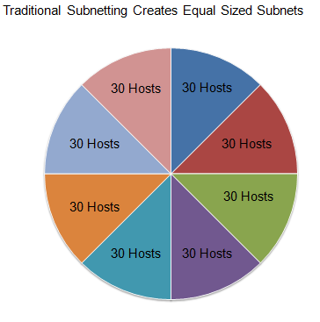
Traditional Subnetting: Equal Addresses
Subnets that require fewer addresses have unused (wasted) addresses
For example, WAN links only need two addresses.
Notes:
9.1.4.1 Traditional Subnetting Wastes Addresses

Slide 28
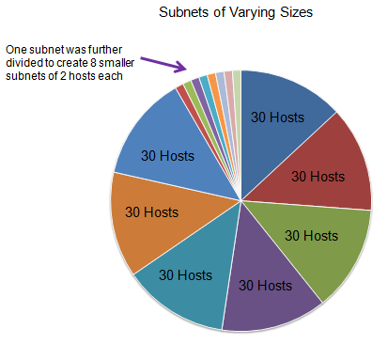
Variable Length Subnet Masks (VLSM)
The variable-length subnet mask (VLSM) or subnetting a subnet provides more efficient use of addresses.
VLSM allows a network space to be divided in unequal parts.
Subnet mask varies, depending on how many bits have been borrowed for a particular subnet.
Network is first subnetted, and then the subnets are resubnetted.
Notes:
9.1.4.2 Variable Length Subnet Masks (VLSM)

Slide 29
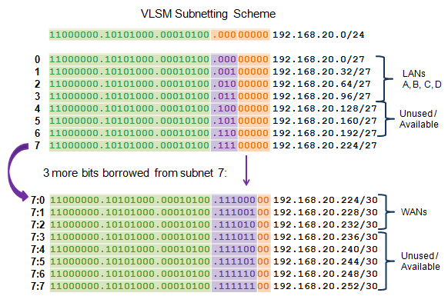
Benefits of Variable Length Subnet Masking Basic VLSM
Notes:
9.1.5.3 Basic VLSM

Slide 30
Creating Eight Subnets (Cont.)
Notes:
9.1.3.5 Creating 8 Subnets (Cont.)

Slide 31
Let us do another example ..

